Slide 1
CHATBOT WORKSHOP
Phi Huynh – Loi Le – Quang Huynh

Slide 2



Agenda
1
2
AI at a glance
Chat Bot
3
Microsoft Bot Framework
4
Exercise 1 & 2
5
6
LUIS
Exercise 3
7
8
Principles of bot design
Design a conversion flow

Slide 3
At the glance

Slide 5
Machine Learning
Is what “gives computers the ability to learn without being explicitly programmed.”
Athur Samuel - “Some Studies in Machine Learning”
Sample Data
Input
ML
Algorithm
Training
MODEL
Input Data
Input
MODEL
Calculate
Prediction

Slide 6
Machine Learning
ML Algorithm is the way to get the Model. Plenty of them. Based on your need, pick a Algorithm – Or not: Sometime applying unrelated algorithm give excellent Model (e.g.: apply Near-optimal computing, Fuzzy, G.A… for extremely fast learning)
Feature: Properties of input data
Label: Properties of output

Slide 7
Machine Learning
Supervised learning: used when training data can be labeled up front, find patterns to predict the values of the label on additional unlabeled data; commonly used in applications where historical data predict future events
Unsupervised learning: used when training data cannot be labeled up front, find structure of input data. Applied for clustering (categorizes) or association (recommendation)
Semi-Supervised Learning
Reinforcement learning: is when a machine is not explicitly supplied training data. It must interact with the environment in order to achieve a goal (play game, self driving cars)

Slide 8
MACHINE LEARNING APPLICATION
SPEECH | RECOMMENDATIONS
Speech Recognition (What) | Frequently Brought Together (FBT)
Voice Recognition (Who) | Item-to-item Recommendation
Text To Speech (TTS) Speech To Text (STT) | Recommendation based on past activities
COMPUTER VISION | LANGUAGE
Object detection | Natural Language Understanding – NLU
Image Recognition | Natural Language Proceeding – NLP/NLT/NLG
Face Detection
Optical Character Recognition

Slide 9
MACHINE LEARNING APPLICATION
Vision • Computer Vision API • Content Moderator API • Emotion API • Face API • Video API • Custom Vision Service • Video Indexer | Speech • Bing Speech API • Custom Speech Service • Speaker Recognition API • Translator Speech API
Knowledge • Academic Knowledge API • Entity Linking Intelligent Service • Knowledge Exploration API • QnA Maker API • Recommendations API • Custom Decision service | Language • Bing Spell Check API • Language Understanding Intelligent Service • Linguistic Analysis API • Text Analytics API • Translator API • WebLM API

Slide 10
Chat Bot

Slide 11
WHAT
Is a computer program
Used to conduct a conversation and interact with human
Often designed to simulate human behavior
Able to understand conversation by:
Keywords and intents
Natural languages
Both
Able to conduct conversation:
Freely using natural languages
Pre-defined conversation structure

Slide 12
WHAT FOR
Customer service & support
Virtual assistant
Marketing (spam/scam)
Toys
CLI tools running on Messages systems
Research tool

Slide 13
WHERE
Any Message System
Call Center
Marketing (spam/scam)
Web
SMS
…

Slide 14
WHY
They’re fast and accurate
Automated, low cost, have no “personal problem” or “human mistake”.
Can handle tons of concurrence conversations, perform complex tasks without making mistake
Free human for more important task
Available 24/7. Don’t mind overtime, don’t ask for increasing salary.
Record statistics data for …
Super cool and trendy
... What else, guys?
According to Juniper research, chatbots will be responsible for costs savings valued over $8 billions annually by 2022

Slide 15
WHY NOT
It’s not human. It’s does not sense
User who realizes talking to a bot might feel odds/bored and uncomfortable/un-trustable.
It’s a combination of algorithms. It’s can make mistakes
It’s not for every business
It’s might unpredictable

Slide 16
CHAT BOT
CHAT BOT FRAMEWORKS | CHAT BOT PLATFORM
Predefined architect, functions, classes that help faster development | Ecosystem to create, train, deploy chat bots for use
Used by developer to build bots using programming language | Used by beginner or non high-tech users to develop bots with minimum codes or configurations

Slide 17
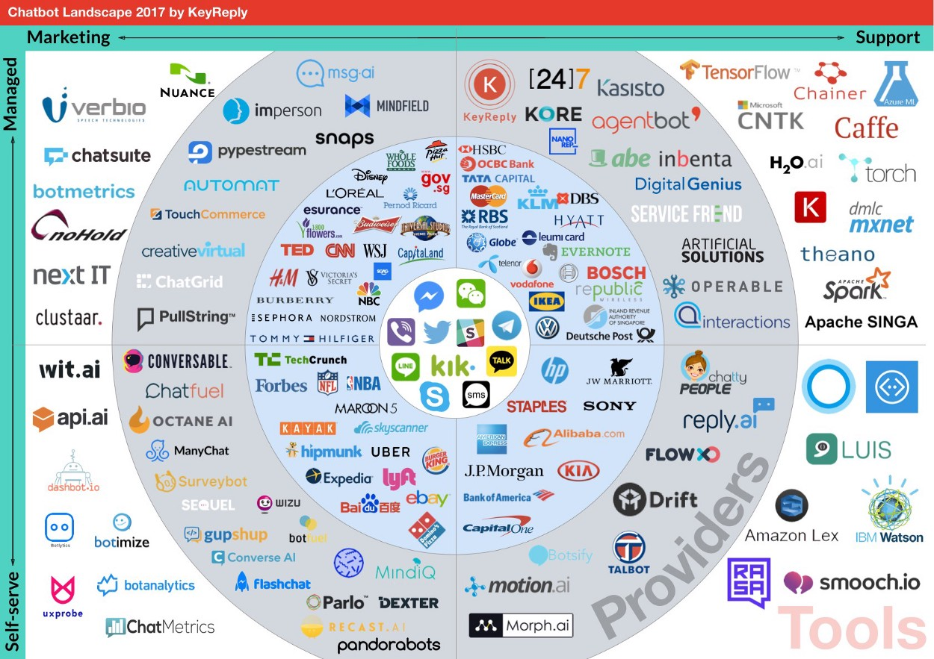

Slide 18
JOURNEY OF A CHAT MESSAGE
1.User sends message
2.Chatbot gets the message
4.Chatbot processes for output
5.Chatbot replies message containing output
3.Chatbot parses the message

Slide 19
COMMON TERMS
Channel: The client to communicate to
Connector: Connect the channel to the chat bot
Utterance: What user says
Intent: What actions (verb) the bot understand from user’s utterances.
Entity: What input (noun) for the intents to perform on

Slide 20
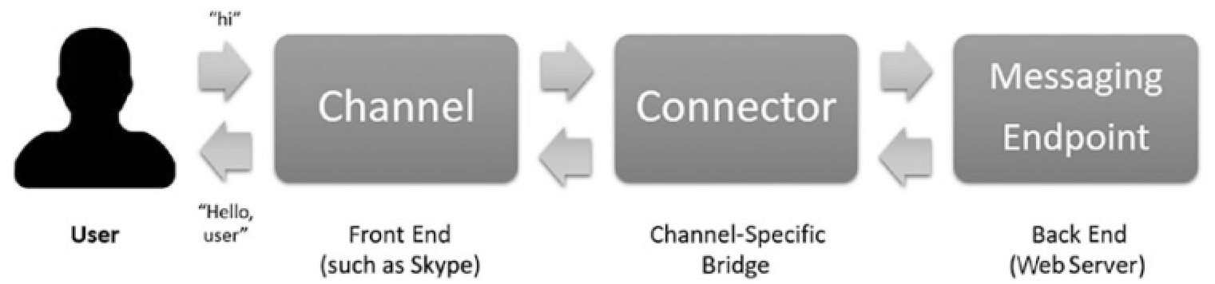
COMMON TERMS
Card: Rich format message type from a bot replying to user
Dialog: A pre-constructed of conversation context which the bot use to communicate with user, to archive a specific goal.
Conversation flow/Dialog waterfall: Interaction between dialogs which the bot use to perform chat to user
CUI Conversational User Interface, comparing with GUI/CLI?

Slide 21
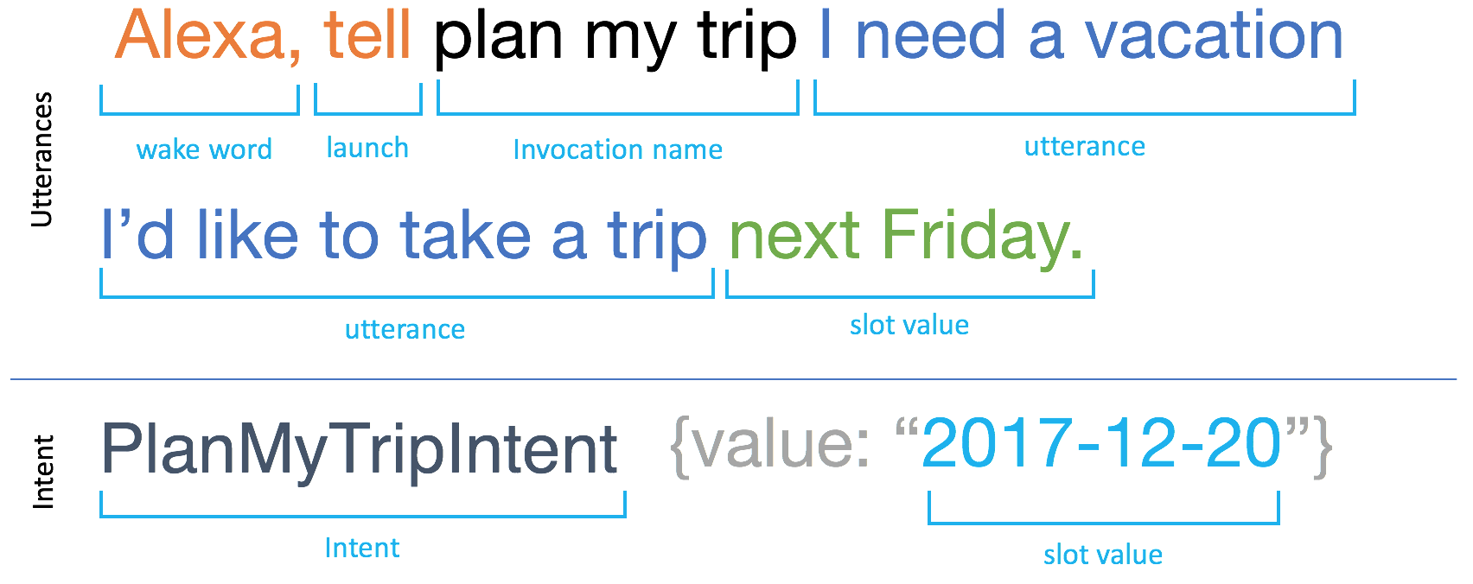
Let’s try
Channels
Utterances
Intents
Entities

Slide 22
Microsoft Bot Framework

Slide 23
Introduction
https://botframework.com
Open source SDKs
Help to quickly write bot logic and deploy into bot platform
Is NOT a part of MS cognitive Service
Not tighten up to Azure, but Azure supports it with many templates

Slide 24
TOOLS
MS Visual Studio 2017/Code
Bot Framework Emulator
ngrok

Slide 25
MS CHAT BOT FRAMEWORK
1.User send message
2.Chatbot get the message
4.Chatbot process for reply data
5.Chatbot create reply message with data
3.Chatbot parse the message
*Dialog:IDialog
MessageController:
APIController
Forward message to a Dialog context: IDialogContext

Slide 26
DEBRIEF
Activity: is information sent by user or client to the chatbot, e.g: user enter the chat, typing, pinging …
MessageController: is API end point to handle Activity, and pass it to the Dialog
Dialog:IDialog: Is to handle the dialog with user from it initialization to it finish. It has IDialogContext as it context to manage and store the conversation all along. It process the incoming message to get the data and create a reply message back to user. It can also forward the message to other dialog.

Slide 27
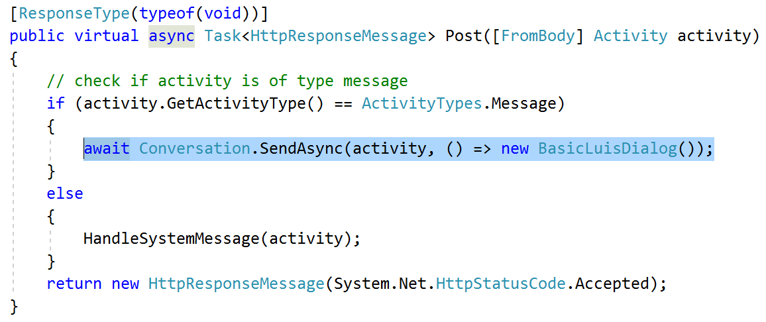
MessageController:ApiController
Is the Api endpoint of the chat bot
Manage the IDialogContext
Pass the activity to a Dialog to handle

Slide 28
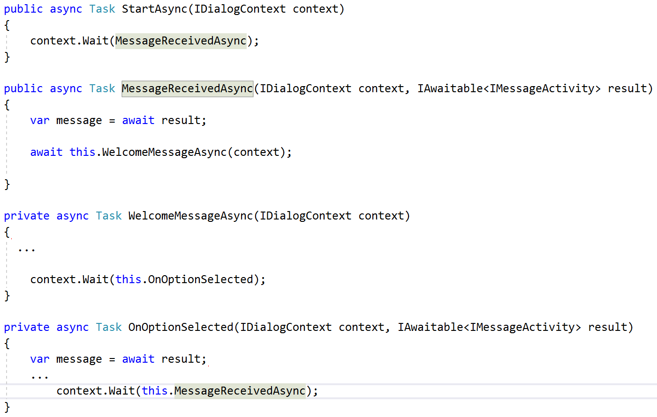
IDialog
Handle the message
Calculate the output
Create response message
Can pass the message to the following or parent dialog

Slide 29
Exercise 1 & 2

Slide 30
HOW ABOUT TESTING
What to test:
Does the bot functioning properly?
Does the bot response correctly?
Challenge:
Chatbots can vary the things they say
A bot can say the wrong thing in the right way
Isolating third party components
T&T:
http://www.qmetry.com/qmetry-bot-tester/
https://www.npmjs.com/package/bot-tester

Slide 31
MAKE IT SMARTER
1.User send message
2.Chatbot get the message
4.Chatbot process for output data
5.Chatbot create reply message with data
3.Chatbot parse the message
NLG
Rich card
Hero card
NLU

Slide 32
LUIS

Slide 33
TYPICAL USE CASE
Scenario 1 | Scenario 2
User: I want to order a pizza. Bot: Sorry, I couldn’t understand. User suddenly remembers that this machine can only understand commands. User: order pizza 1 large margarita Bot: Thanks, your order has been placed. Do you want to order more? (Y/n) User: No. Bot: Sorry, I couldn’t understand. User pulls her hair, close the chat. | User: I want to order a pizza. Bot: Great. What type of pizza would you like? User: Umm… I think Id like a Margarita. Wait, I think I’ll go with Pepperoni. Bot: Is it a Margarita or a Pepperoni? User: Pepperoni. And make it large. Bot: Good. Would you like any sides? User: Nope, I’m good without them. Bot: Cool. Your order for 1 Pepperoni pizza has been placed successfully. Bot: I’ll let you know when you order is dispatched. Bot: Is there anything else I can help you with? User: Nope, thank you. Bot: Thanks for ordering. Have a good day.

Slide 34

LUIS
Microsoft’s natural language understanding cloud service, part of the Cognitive Services suite.
Work on Utterance, Intent and Entity schemes and provides several other building blocks to allow for creating rich NLU applications.
LUIS application is NOT the actual software application but the language-understanding part of other software.

Slide 35
LUIS
Currently supports NLU in nine language cultures: English, Chinese, French, Spanish, Italian, German, Japanese, Brazilian Portuguese, and Korean.
Apply supervised learning technique
Of course, cannot 100% accurate

Slide 36
LUIS RESPONSE
{
"query": "define sumptuous",
"topScoringIntent": {
"intent": "GetDefinition",
"score": 0.9820167
},
"intents": [
{
"intent": "GetDefinition",
"score": 0.9820167
},
{
"intent": "None",
"score": 0.03545451
},
{
"intent": "Hello",
"score": 0.00300396071
}
],
"entities": [
{
"entity": "sumptuous",
"type": "Phrase",
"startIndex": 7,
"endIndex": 15,
"score": 0.851388454
}
]
}

Slide 37
ADD LUIS TO BOT
1.User send message
2.Chatbot get the message
4.Chatbot process for output data
5.Chatbot create reply message with data
3.Chatbot parse the message
NLU: LUIS

Slide 38
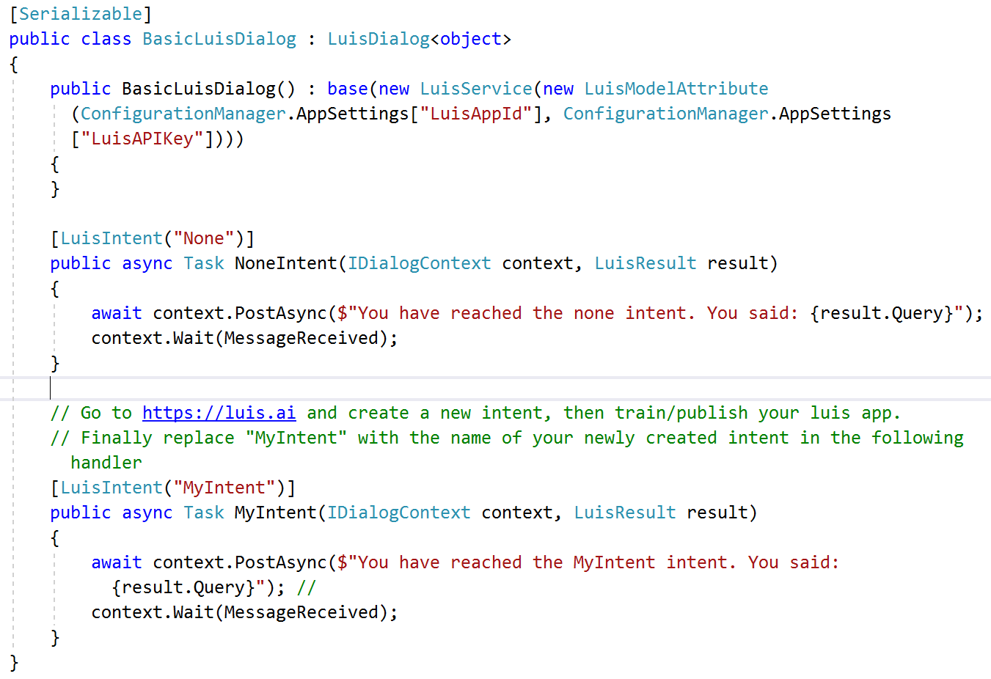
LuisDialog: IDialog

Slide 39
BEST PRACTICES ON TRAINING LUIS MODEL
Lower down number of intents
Grouping intents to have better CUI
Apply naming convention for intents and entities
Use proper entities types. Remember to add alternative values for list entities
Leverage LUIS built-in intents
Beware LUIS is not from your country
Monitor the model, improve it regularly
Versioning

Slide 40
Exercise 3

Slide 41
PRINCIPLES OF BOT DESIGN

Slide 42
Make The Bot Human
Always reply in full sentence
Develop a character for the bot
Combining chat bots with emotional analytics
Be proactive, when change dialog context should have a linking sentence
Take lead. The bot is the boss
Start a fight
Notes:
Give it a full name, avatar, sex, age, basic profile
Can the bot be fun (internet language, emoj., shorten sentence), serious (call user sir/madam), annoyed (“Sigh”, “whatever”, “but why on earth…”)?
Confirm: “Is that what you think?” “Let’s agree on..”
Invalid input: "Well, I don't agree”
Warning: “It’s not safe…”, “ I’m afraid..”
Success: “Well done” “Sweet” “Boom” “Yeah right”

Slide 43
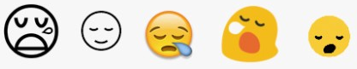


MAKE THE BOT HUMAN: EMOJ
Catchy for idea
User can understand in the way they’re intent to expected
It’s images, worth thousand words [example]
Bot can understand/reply in emoj = bot can think super cool and lively
More handy and easier to understand comparing to image
Pitfall:
Misunderstand
Different channels has different emoj with same code
https://chatbotsmagazine.com/why-emoji-fit-perfectly-for-chatbots-e9c3e8d433ad

Slide 44
Principles Of Bot Design
Users will prefer the bot experience over alternative experiences
A great user experience should be the number one priority
There are no correlation between a bot's intelligence and user adoption
Conversational capability is nothing unless the bot addresses the problems that your users need to solve
Consider whether voice is the appropriate channel for the given problem
The very first interaction between the user and bot is critical to the user experience.

Slide 45
DESIGNING A CONVERSATION FLOW

Slide 46
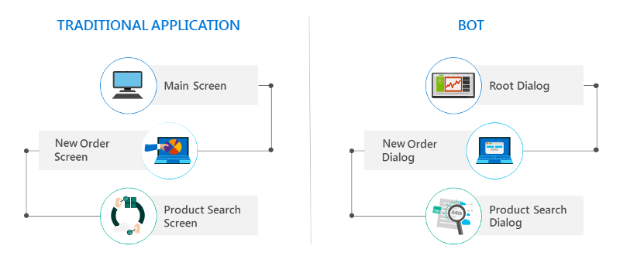
Dialog Stack

Slide 47
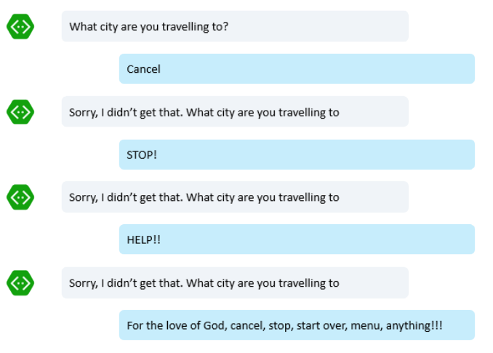
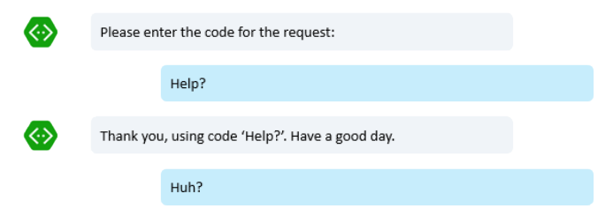
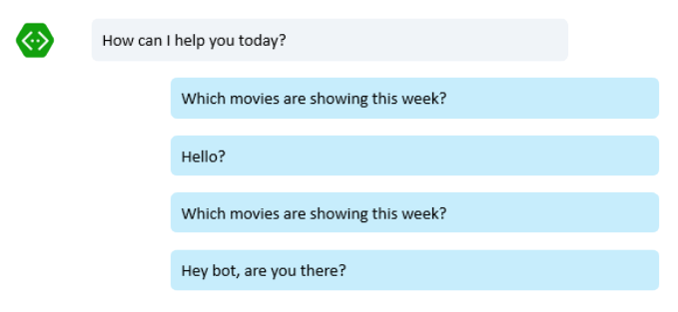
Bad Design
The "stubborn bot"
The "clueless bot"
The "mysterious bot"

Slide 48
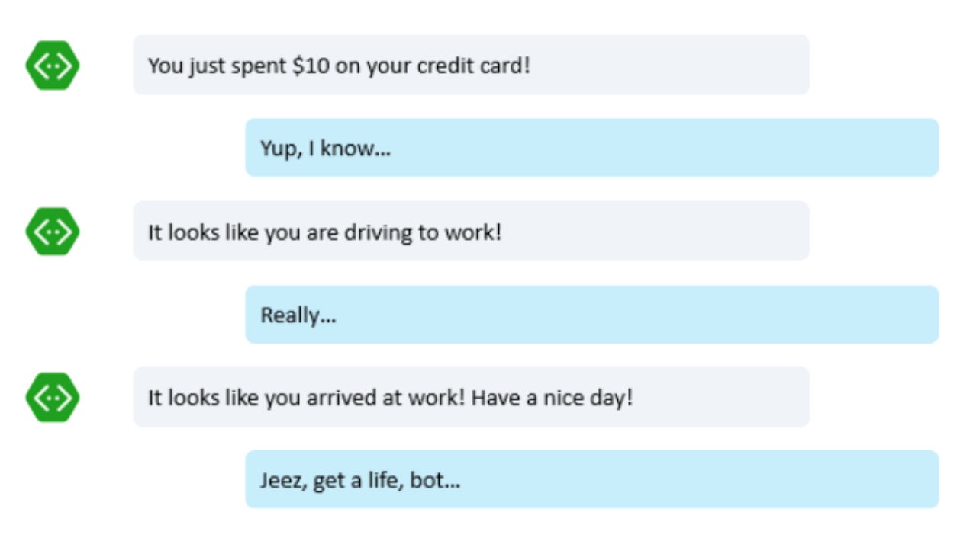
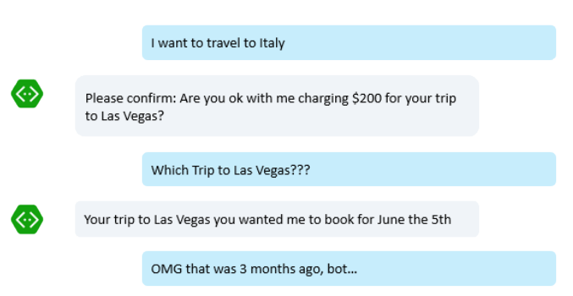
Bad Design
The "captain obvious bot"
The "bot that can't forget"

Slide 49
How to design a conversation flow
Must have CUI (Conversational User Interface) first
Define channels for the bot
Define common fall back: what if user misspell/quit/cancel etc..
Base on CUI, decide to use AI services or not
Base on CUI, define intents
Base on CUI, defines non-happy, corner cases
API services should be with async

Slide 50
How to design a conversation flow
List what the bot can do
Strategy for Start Over/Quit/Cancel/Not understand etc…
Inform user that the bot can or cannot understand
Deal with technical issues
Deal with ambiguities

